Slide 1
Passing the Objective Assessment
How to Prepare for the LPI Linux Essentials Certification Exam
C851 Cohort Session for Sunday, August 1, 2021
Dr. John S. Galliano | C851 Course Instructor

Slide 2
Agenda
Welcome
The 5 Exam Domains
Exam Specifics
Demos/Hands-on
Sample Exam Questions
Wrap-Up

Slide 3

5 Exam Domains
The Linux Community and a Career in Open Source
Finding Your Way on a Linux System
The Power of the Command Line
The Linux Operating System
Security and File Permissions
Notes:
• Understanding the Linux industry and the open source movements
• Understanding the major components of a Linux distribution
• Gaining the technical proficiency to work on the Linux command line
• Gaining a basic understanding of security and administration in Linux
• Gaining a basic understanding of how to work with users, groups, and permissions

Slide 4

About the Exam
No prerequisites
Closed book, up to 60 minutes
40 multiple-choice (with some multi-select and fill-in-the-blank items) questions
Minimum pass score 500 points (200-800 scale)
Partially correct responses not accepted
For F-I-T-B questions LPI often accepts multiple correct versions of an answer¹
Lifetime certification
1. Example: with/without leading path in a case where the answer is a command

Slide 5

useradd
Adds a new user to your system
Creates a user with the defaults in the file /etc/default/useradd
Copies default files from the /etc/skel directory
Pass the name of the user as an argument
verb options arguments
useradd -m –u 1001 radha

Slide 6

useradd does 3 thigns
Edits /etc/passwd, /etc/shadow, /etc/group and /etc/gshadow files
Creates and populates a homedir for new user
Sets permissions/ownerships to homedir

Slide 7
useradd examples
sudo useradd -u 1001 radha
id -u radha
cat /etc/passwd | grep radha
sudo ls -laR /home/radha

Slide 8
useradd examples
sudo useradd -u 1002 -M gary
id -u gary
cat /etc/passwd | grep gary
ls -laR /home/john
sudo useradd -e 2021-08-02 kris
sudo chage –l kris
sudo useradd -c “Hi Dana” dana
cat /etc/passwd | grep dana

Slide 9
useradd examples
sudo useradd -d <path to homedir>
sudo useradd -u <UID>
sudo useradd -g <GID>
sudo useradd -s <shell>

Slide 10
userdel
sudo userdel -f new_user
sudo userdel -r old_user

Slide 11

Let’s Do Some Demos!
If you want to follow along, fire up your VM
Notes:
• Understanding the Linux industry and the open source movements
• Understanding the major components of a Linux distribution
• Gaining the technical proficiency to work on the Linux command line
• Gaining a basic understanding of security and administration in Linux
• Gaining a basic understanding of how to work with users, groups, and permissions

Slide 12
What Questions Do you Have for Me?

Slide 13
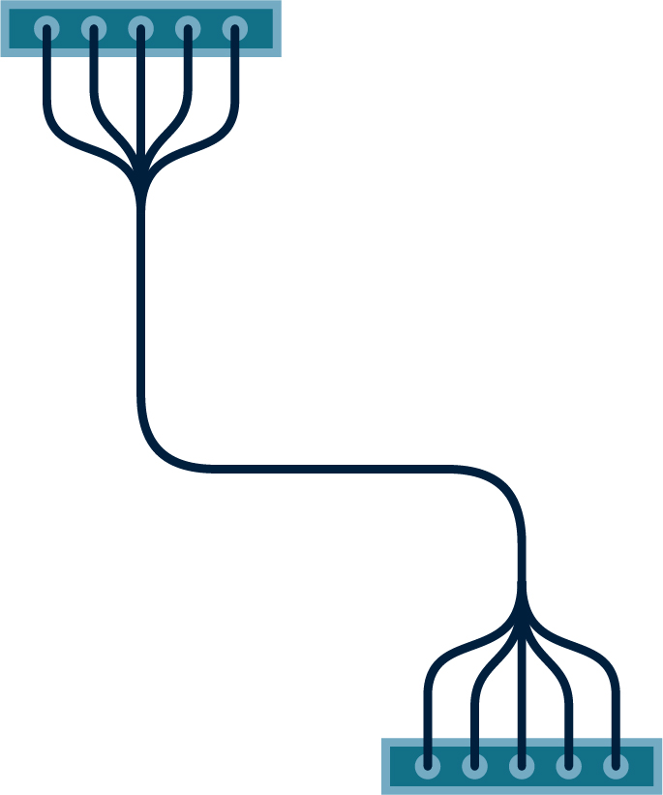






























Icon Library - Page 1

Slide 14



























































Icon Library - Page 2

